Slide 1
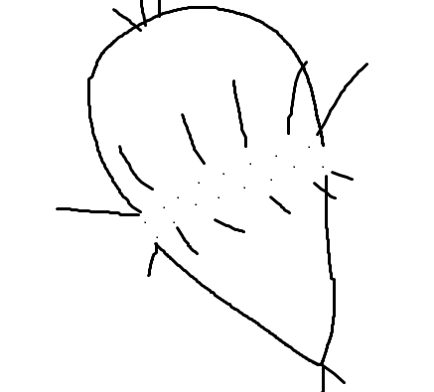
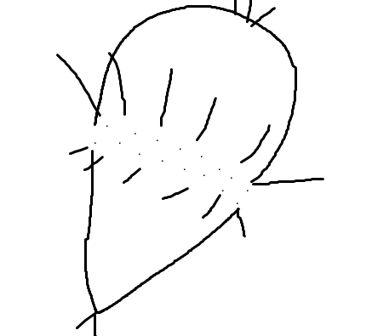
The Effect of Feeding Type And Particle Size Distribution on Metamorphosis Rates in Marine Larval Invertebrates
Amberle McKee

Slide 2
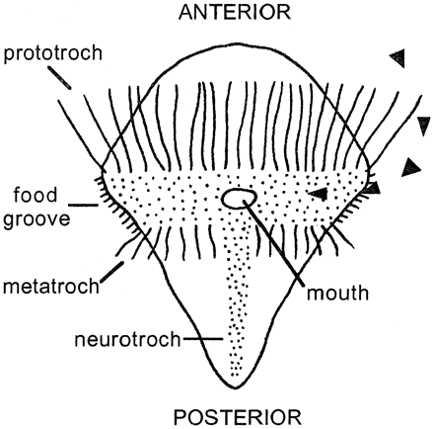
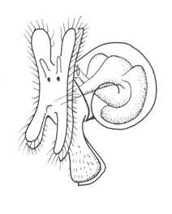
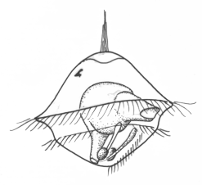
Opposed Band Feeding

Slide 3
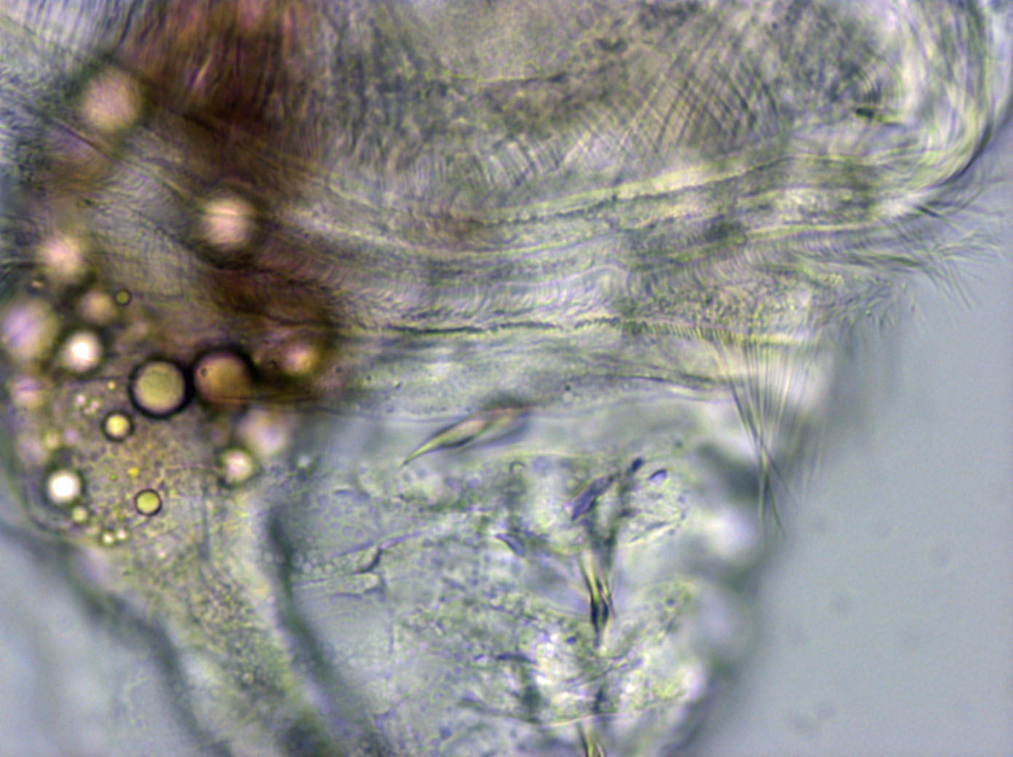
Opposed Band Feeding
Prototroch
Food Groove
Metatroch

Slide 4
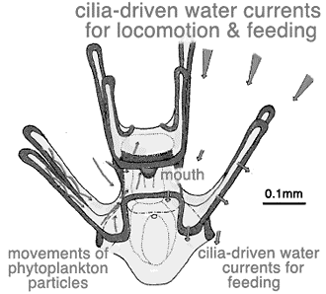
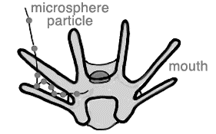
Ciliary Reversal Feeding

Slide 5
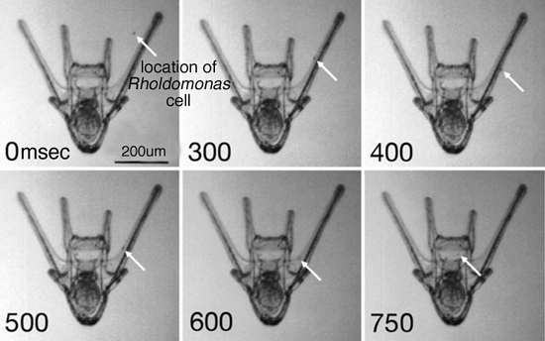
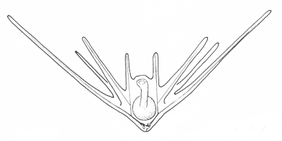
Ciliary Reversal Feeding

Slide 8
?
Which feeding technique will be most successful in which
environment?
Specifically: Will one feeding technique result in more larvae
metamorphosing in a particular feeding environment than the
other?

Slide 9
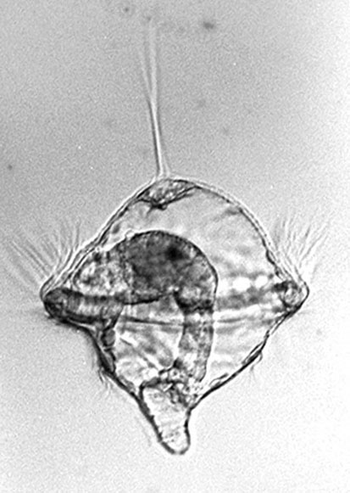
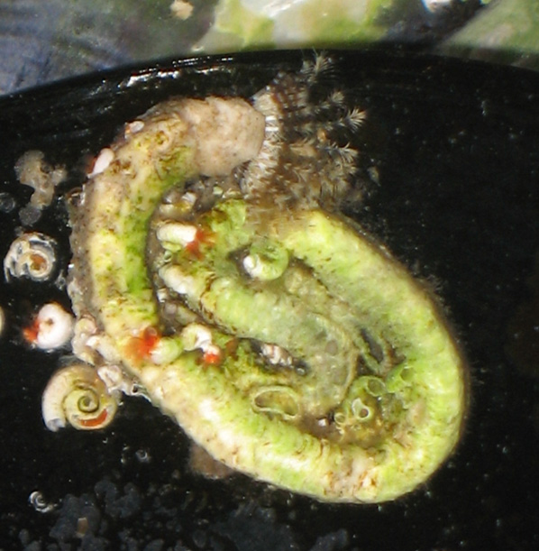
Hydroides - Worms

Slide 10
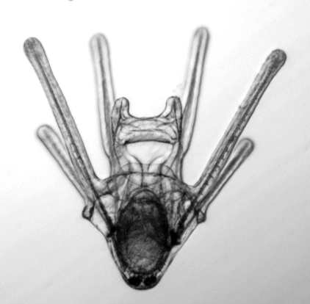
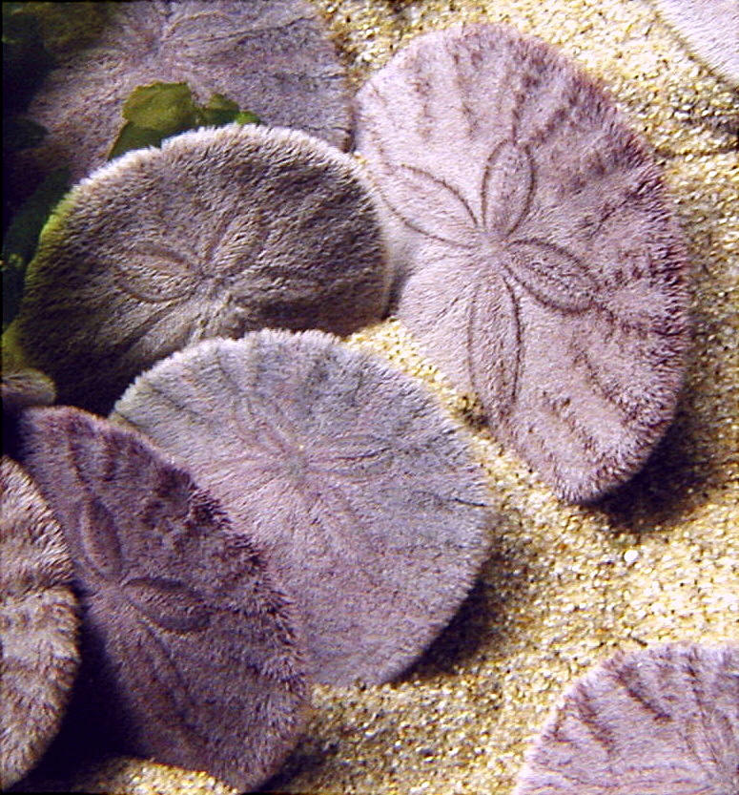
Dendraster – Sand Dollars

Slide 11
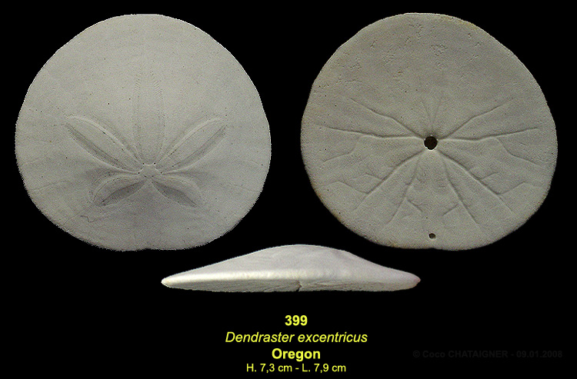

Slide 12
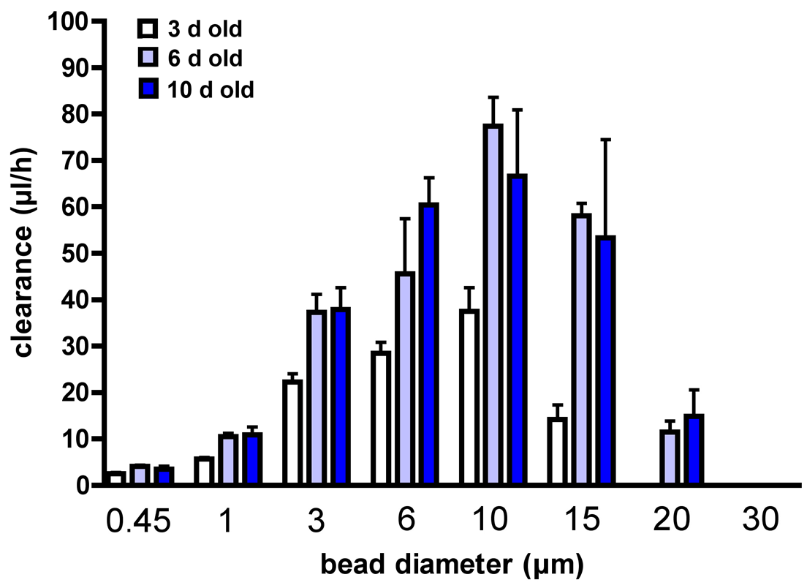
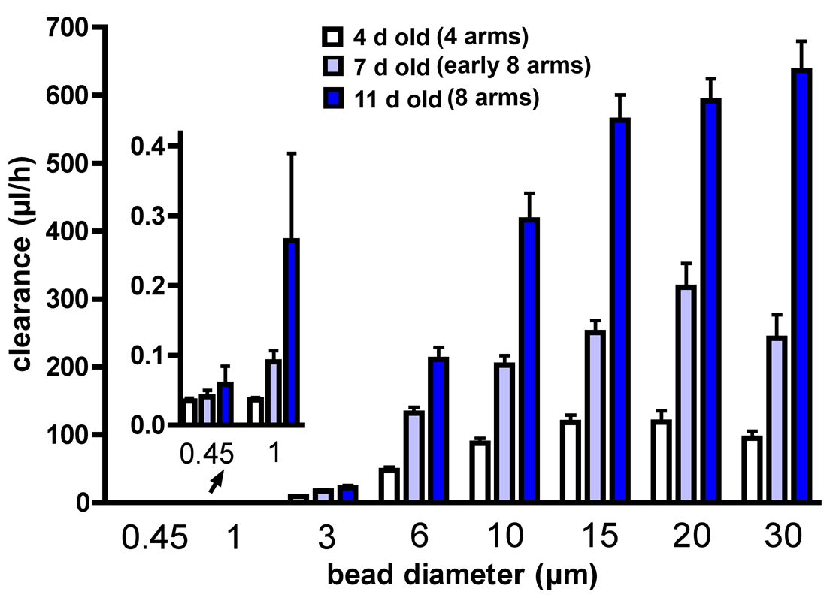
Hydroides Dendraster

Slide 13
Flow Chart
Zygote
Stage 1
Stage 2
Stage 3
Metamorphosis

Slide 14
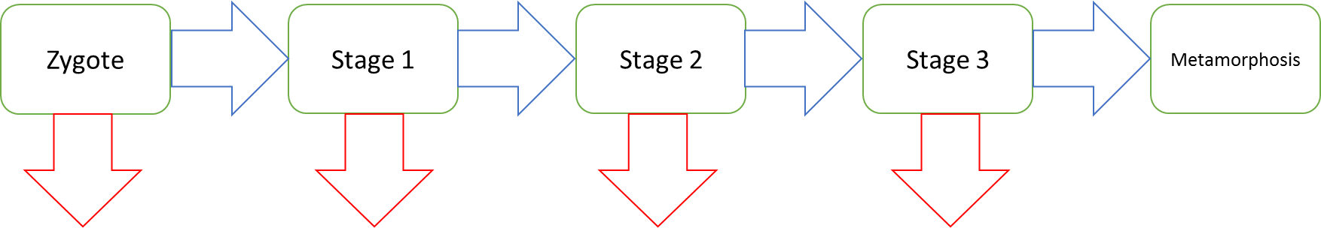
State Variables
z : non-feeding zygote stage
s₁, s₂, & s₃ : three size classes between zygote and metamorphosis
m : metamorphosed adults

Slide 15
Parameters
a_{z} : rate of transition from non-feeding Zygote stage to Stage 1
a : amount of carbon needed to advance to the next stage
f : the amount of carbon in the environment
p : the proportion of food available in each size of food particle
x : clearance rate (feeding rate) of individual
d : death rate

Slide 16
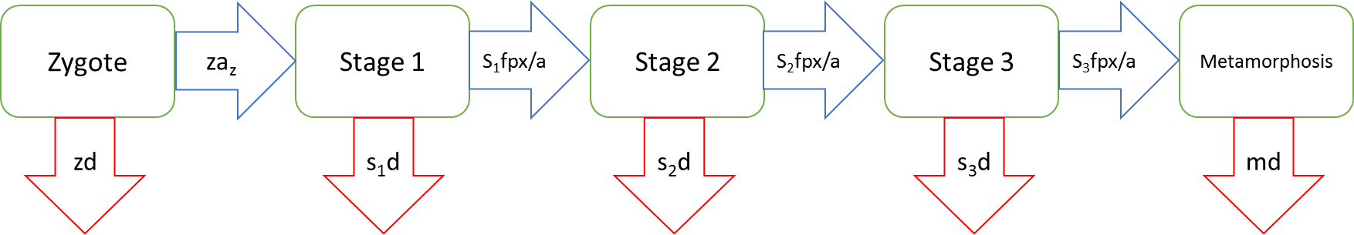
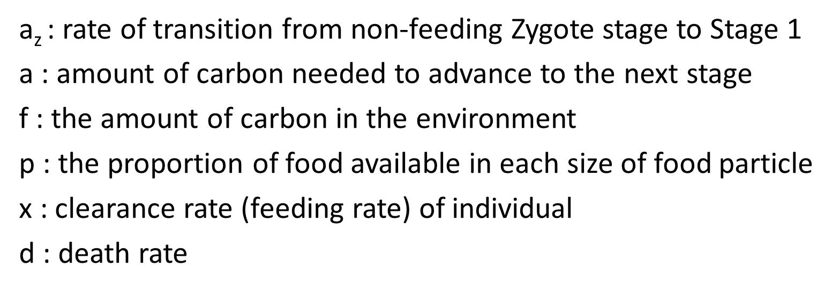
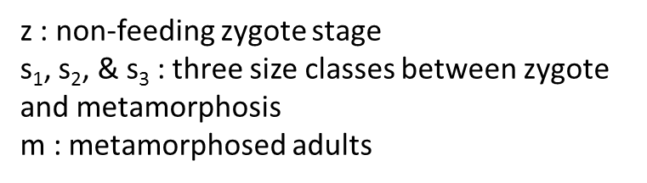
Flow Chart

Slide 17
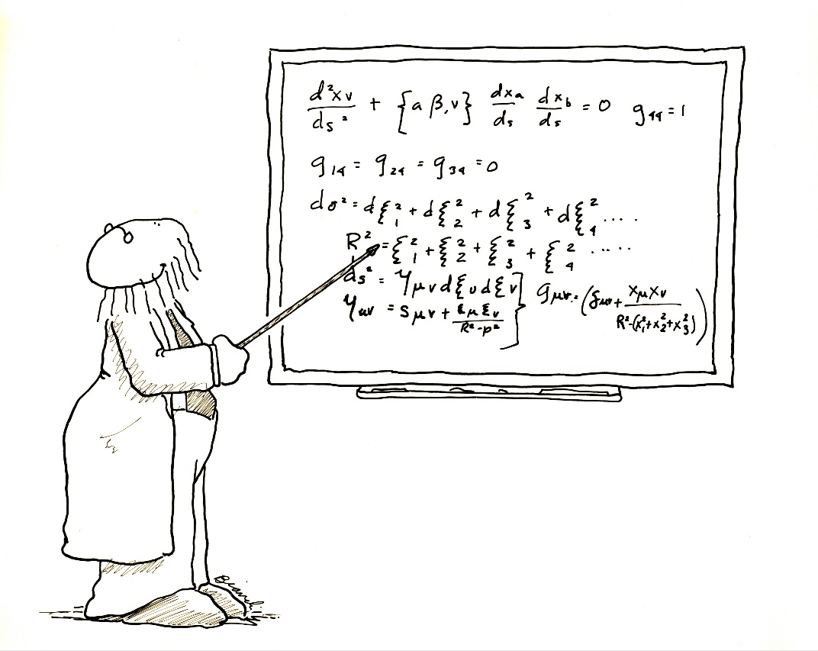
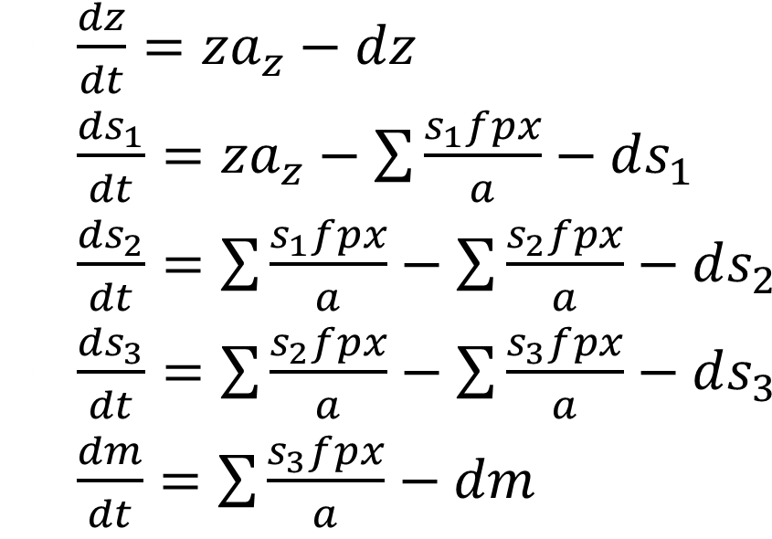

Slide 18
Actual Parameters Used
az=0.8,a=11780972.45,f=23561944.9,d=0.2,
#p=the proportion of carbon in each food size
p.45=0.125,p1=0.125,p3=0.125,p6=0.125,
p10=0.125,p15=0.125,p20=0.125,p30=0.125,
#x1=the clearance rate of stage 1 larva on different size food
x1.45=2.53,x11=5.67,x13=22.28,x16=28.44,
x110=37.51,x115=14.22,x120=0,x130=0,
#x2=the clearance rate of stage 2 larva on different size food
x2.45=4.10,x21=10.52,x23=37.30,x26=45.60,
x210=77.43,x215=58.07,x220=11.46,x230=0,
#x3=the clearance rate of stage 3 larva on different size food
x3.45=3.49,x31=10.91,x33=37.88,x36=60.49,
x310=66.67,x315=53.34,x320=14.87,x330=0)

Slide 20


Slide 22
Hydroides Dendraster

Slide 23
Why?

Slide 24
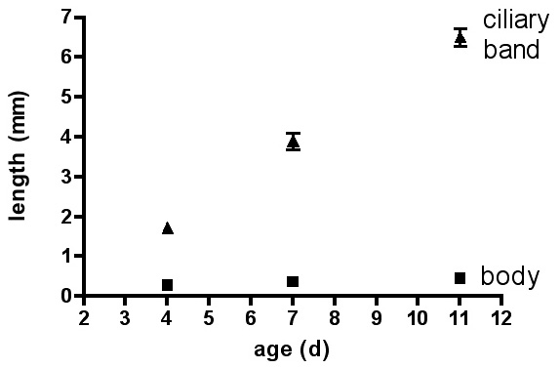
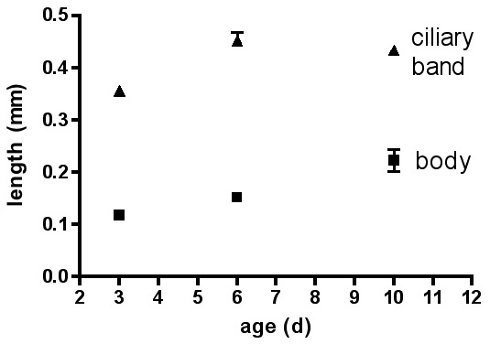
Dendraster excentricus
Hydroides gracilis

Slide 25

Future Directions
Data from many more opposed band and ciliary reversal species will be used to clear up the size issue
Model will be remade to determine relative times to metamorphosis

Slide 26
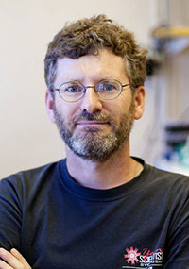

Acknowledgements
Dr. Bruno Pernet – experimental data and consultation
Dr. Darren Johnson – mathematical and R coding consultation

